Slide 1
ML Frameworks and Optimised Libraries (Chapter 3)

Slide 2
Learning Objectives
Cost & Energy Efficiency with CPUs:
Understand how leveraging CPUs reduces capital/operational expenses.
Challenges of Increasing Model Complexity:
Identify the impact of growing compute requirements, memory bandwidth limits, and latency constraints.
Graph-Based Computation:
Explain how computation graphs (DAGs) model operations and data flow.
Execution Modes & Compilation Techniques:
Differentiate between graph mode (static/compiled) and eager mode (dynamic) execution.
Framework Ecosystem:
A variety of frameworks and libraries (e.g., PyTorch, Arm Compute Library, Llama.cpp) support these optimizations, catering to diverse deployment scenarios—from cloud to edge.

Slide 3
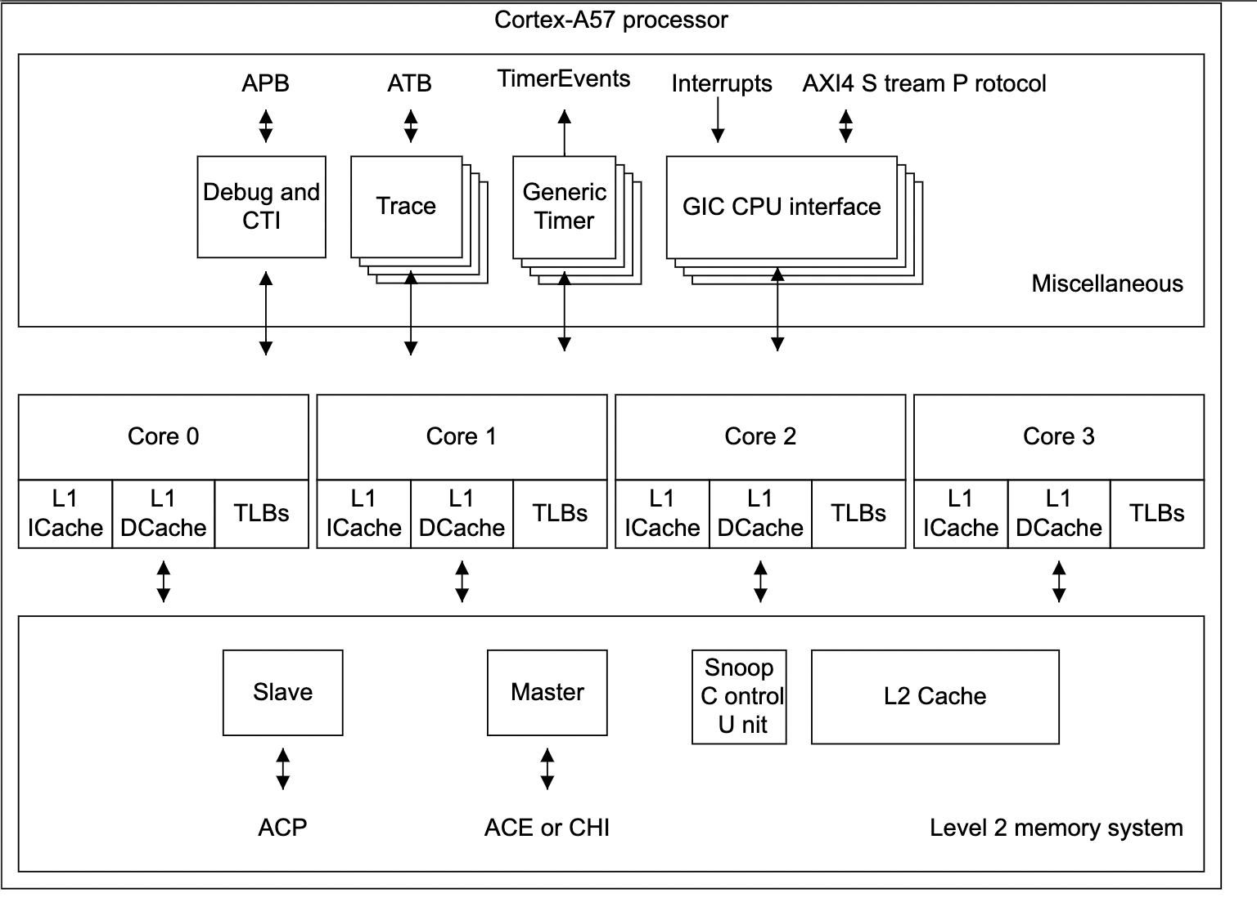
Why Optimize for CPU Inference?
Cost Efficiency:
Leverage existing CPUs to lower capital and operational expenses versus investing in specialized GPUs.
Ubiquity:
CPUs power most edge devices and servers, ensuring broad compatibility and seamless integration.
Energy Efficiency & Latency:
Tailored optimizations (e.g., vectorized operations) reduce energy consumption and deliver fast, real-time responses.
Data Security:
Local inference minimizes data transmission, enhancing privacy and simplifying compliance with regulations.
Cortex-A57 Processor

Slide 4
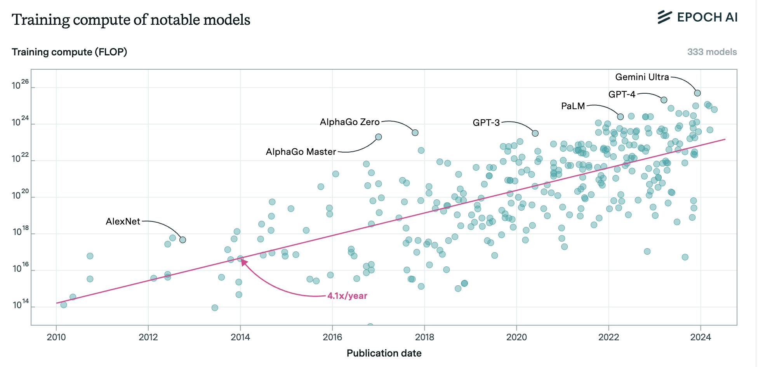
Revisiting CPU Inference Challenges
Increasing Model Complexity:
Generative AI Model compute requirements are growing 4-5x per Year.
Memory & Data Throughput Bottlenecks:
Large models demand high memory bandwidth and efficient data movement, which can stress CPU memory hierarchies.
Scalability:
The heavy computational load of generative AI challenges multi-threaded processing and optimal core utilization on CPUs.
Stringent Low-Latency Demands:
Real-time inference applications require minimal latency, posing difficulties for traditional CPU setups under high workloads.
Jaime Sevilla and Edu Roldán (2024), "Training Compute of Frontier AI Models Grows by 4-5x per Year". Published online at epoch.ai.

Slide 5
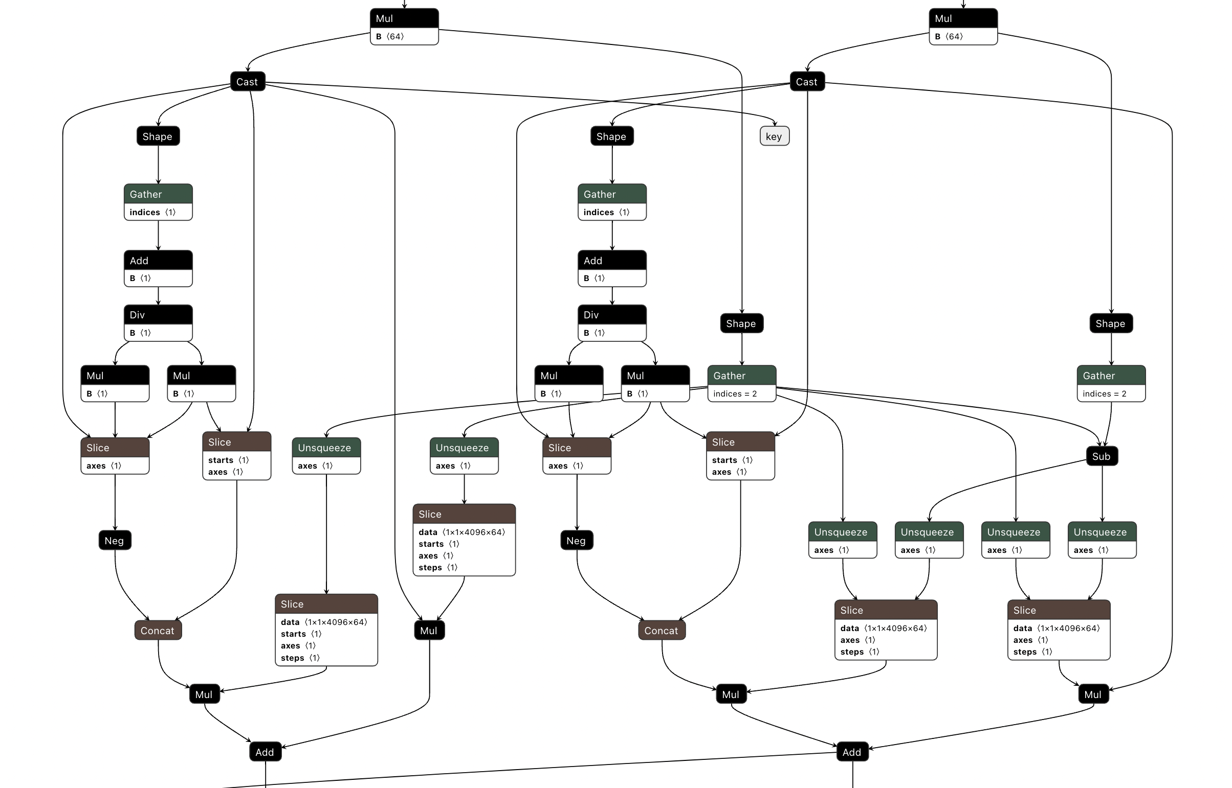
Generative AI Model as a Graph
Graph Structure:
Nodes: Represent operations (e.g., layers, activations, transformations) within the model.
Edges: Depict data flow and dependencies between operations.
Directed Acyclic Graph (DAG):
Ensures a clear, sequential execution order from input to output without circular dependencies.
Visualization & Analysis:
Simplifies understanding and debugging of complex models.
Provides a framework for optimization by identifying redundant operations and enabling parallel execution.
Foundation for Optimization:
Enables advanced techniques like operator fusion, dynamic graph compilation, and runtime scheduling.
Directed Acyclic Graph of Apple OpenELM transformer

Slide 6
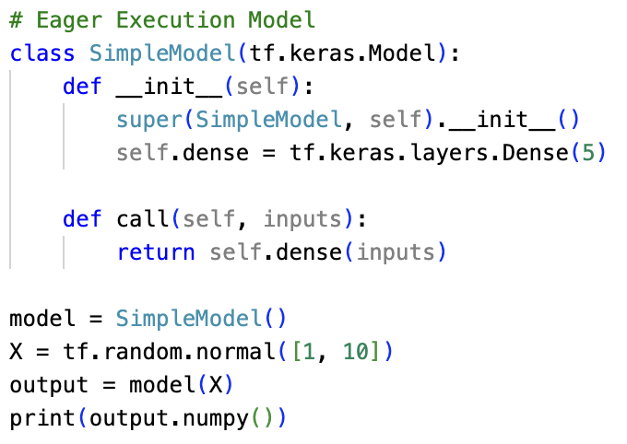
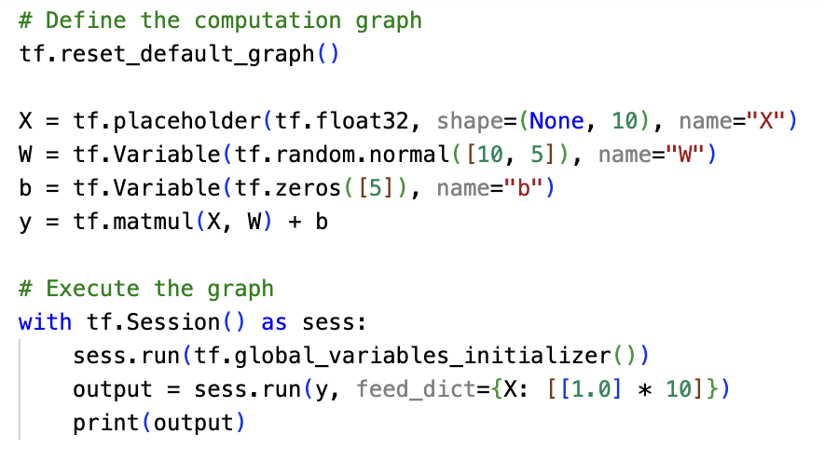
Graph Mode vs. Eager Mode
Graph Mode
Defines the entire computation graph before execution.
Compile-Time Optimizations:
Enables operator fusion, constant folding, and global optimizations
Eager Mode
Immediate Execution:
Opterations execute as they are called, allowing dynamic control flow
East of Debugging
Intuitive and interactive, making it easier to trouble shoot and prototyple.
Limited Global Optimizations:
Fewer opportunities for compile-time performance enhancements.
Eager Execution (Tensorflow 2.x)
Graph Execution (Tensorflow 1.x)

Slide 7
Dynamic Graph Compilation on CPUs
Definition:
The process of transforming a dynamic (runtime-evolving) computation graph into optimized machine code on the fly.
Key Mechanisms:
Just-In-Time (JIT) Compilation: Compile portions of the graph during execution.
Operator Fusion & Inlining: Merges multiple operations to reduce overhead. (e.g. torch.jit.trace(func))
Benefits:
Adaptability: Adjusts to changing input shapes and model behaviour (e.g. nn.AdaptiveMaxPool2d)
Improved Performance: Generates code optimized for current workload, reducing latency
Flexibility: Supports dynamic model structures without a complete recompilation.
Feature | JIT Compilation | Static Compilation
Execution | Dynamic (on-the-fly) | Predefined (ahead of time)
Performance | Optimized at runtime | Optimized before execution
Adaptability | Adjusts to workload | Fixed, less flexible
Overhead | Slight Overhead | High compilation time

Slide 8
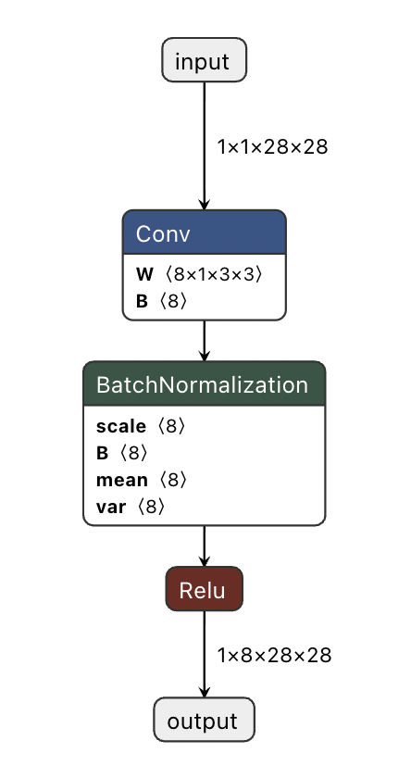
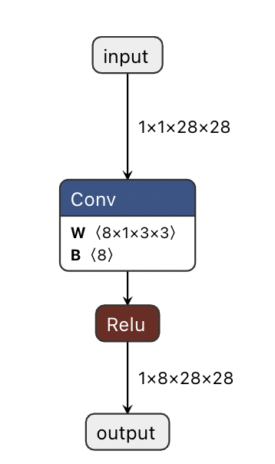
Static Graph Compilation
Definition:
The entire computation graph is defined, optimized and compiled ahead of execution.
The structure remains fixed throughout runtime.
Key Mechanisms:
Operator fusion, constant folding, and memory layout adjustments are performed at compile time.
Global Analysis: Enables comprehensive optimization across the entire graph, considering all dependencies
Benefits:
Enhanced Performance:
Global optimizations yield highly efficient runtime execution
Predictability:
Deterministic execution flow ideal for production environments.
Optimized Hardware Utilization:
Pre-compiled kernels can better exploit specialized CPU features.
Identical Operations, different graphs. Left graph, BatchNorm operation is separate operator. In right graph, BatchNorm has been fused into the preceding convolution layer.

Slide 9


Static vs. Dynamic Compilation – A Comparison
Static Compilation:
Graph fixed and compiled ahead-of-time
Global optimizations yield deterministic performance
Ideal for stable, production workloads.
Advantages:
More predictable performance (fewer surprises at runtime).
Often faster execution for stable workloads.
However, less flexibility if input shapes or control flow vary widely.
Examples
Some deep learning frameworks when using ahead-of-time graph compilation (e.g., XLA, TVM, some ONNX runtime scenarios, Lamma.cpp).
Dynamic Compilation:
On-the-fly JIT optimizations during runtime
Adapts to changing inputs and control flow
Offers flexibility with potential runtime overhead.
Advantages:
Adapts to different runtime conditions.
Easier prototyping and debugging because you can quickly change code.
Might introduce overhead (warm-up time or re-compilation).
Examples
PyTorch’s eager mode, TensorFlow’s eager execution, or TorchScript JIT falls somewhere in between static and dynamic.

Slide 10
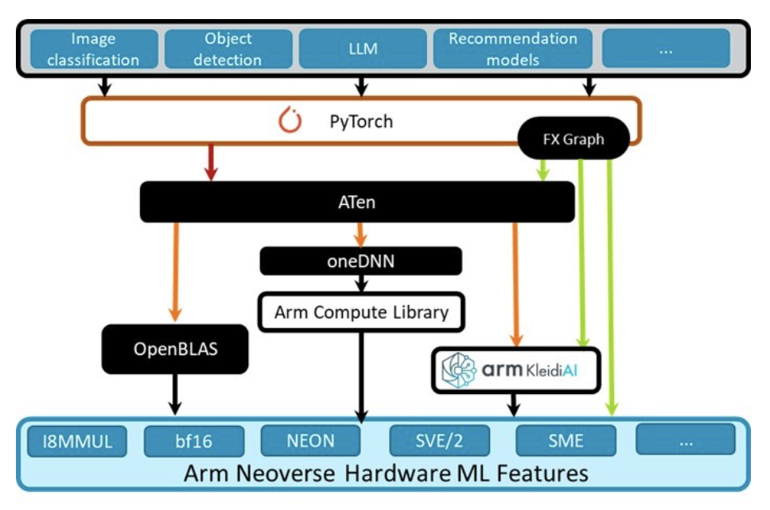
Overview of ML Frameworks on Arm
Supported Frameworks:
Pytorch: Optimized for adaptability, training, developer experience and fast prototyping
LiteRT: Optimized for mobile/embedded inference.
ExecuTorch: Optimized for mobile/embedded inference.
ONNX Runtime: Versatile cross-platform inference engine.
Arm Compute Library: Provides optimized low-level compute routines for static graph inference.
Llama.cpp: Minimalistic pure C++ project for LLM inference.
…
Hardware-Specific Optimizations
Leverages Arm’s NEON/SVE instructions for efficient computation. Through low level libraries.
Custom kernel libraries tuned for Arm architectures (KleidiAI)
An example of an AI stack from high level applications to low-level implementations and Arm specific hardware features.

Slide 11
PyTorch on Arm
User-Level API:
Python functions (e.g., torch.add()) initiate tensor operations
Central Dispatcher:
Routes calls based on tensor type, device and data type
Determines correct implementation
Aten – The Tensor Library:
Acts as the bridge between the dispatcher and low-level kernels.
Provides a unified API for tensor operations
Backend Libraries & Optimizations:
OpenBLAS
On Arm, optimized routines leverage hardware-specific instructions
KleidiAI
Arm specific operator implementations leveraging hardware features including (NEON/I8MM/SVE/SVE2/SME/..)
Extensibility:
Supports custom backends and operator registrations, enabling further hardware-specific tuning.
The Pytorch Stack and it’s dispatching logic.

Slide 12
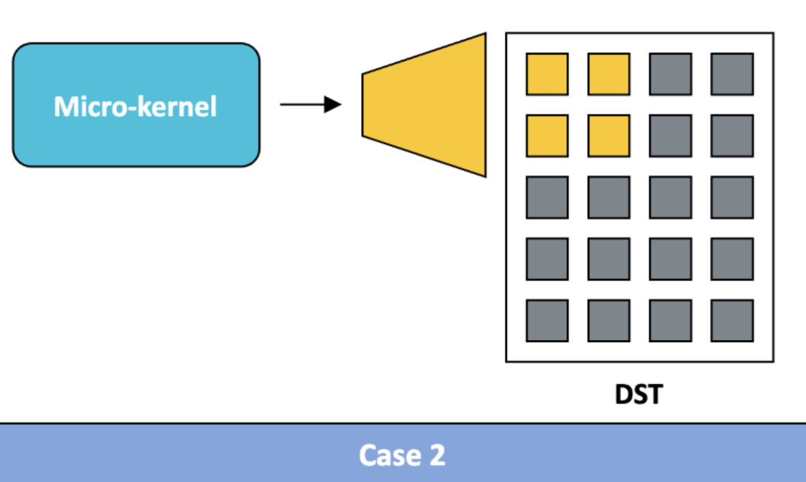
Optimised Libraries – KleidiAI
What Are Micro-Kernels?
Highly optimized low-level compute functions designed to accelerate matrix multiplications and tensor operations.
Used in Arm CPU inference engines to maximize performance for ML workloads.
Why Do Micro-Kernels Matter for Inference?
Cache-Aware Execution: Optimized to fit within CPU cache, reducing memory bandwidth usage
Leverages specialized instructions (e.g., I8MM, SVE, SVE2, DotProd) to process multiple data points in parallel.
Custom implementations for critical operations like GEMM (General Matrix Multiplication) and convolutions.
Designed to operate on only part of the input, so they can be scaled efficiently across multiple CPU cores.
Enables efficient computation with low precision formats such as INT4 and INT8, BFP16.
Example of a Micro-Kernel, that produces a portion of the output, operating on only a portion of the input.

Slide 13

Llama.cpp for Lightweight Inference
Lightweight & Efficient:
Pure C++ implementation designed for minimal memory and computation footprint.
Optimized for CPU:
Tailored for efficient execution on consumer-grade CPUs with low-level optimizations.
Includes integration with low-level Arm optimized operators such as (KleidiAI)
Resource-Constrained Environments:
Ideal for edge deployment and devices with limited resources
Simplicity & Accessibility:
Minimal dependencies and straightforward integration.
Targeted for inference:
Streamlined for inference tasks, balancing performance with resource efficiency
Limited to a select number of LLM Architectures

Slide 14
Summary
Efficient inference on CPUs:
CPUs offer cost, and energy advantages making them viable for a wide range of inference tasks despite rising model complexity.
Optimizing Through Graph Structures:
Using a directed acyclic graph (DAG) simplifies understanding and enables powerful optimizations, such as operator fusion and parallel processing.
Static vs. Dynamic Execution:
Graph mode (static compilation) delivers predictable, optimized performance, ideal for production.
Eager execution and JIT provide flexibility and rapid prototyping, adapting to dynamic inputs and control flows.
Hardware-Level Enhancements:
Leveraging specialized instructions and micro-kernels (e.g. NEON, SVE, I8MM) ensures that CPU inference can meet low-latency and high throughput demands, even in resource constrained environments.
Framework Ecosystem:
A variety of frameworks and libraries (e.g., PyTorch, Arm Compute Library, Llama.cpp) support these optimizations, catering to diverse deployment scenarios from cloud to the edge.

Slide 15
Questions and Discussion

